Slide 1
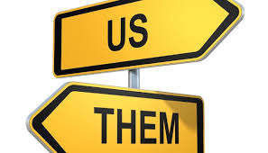
Week 4 Social Categorisation: Us vs Them
COMU7311, Sem 1 2021

Slide 2
Learning objectives
At the end of this lecture, you should be able to:
Understand the processes of perception and social categorisation.
Identify the influence of stereotypes, racism, and ethnocentrism on intercultural communication.

Slide 3
An old or young woman?

Slide 4
The nature of human perception
We respond to sensory stimuli by selecting, organising and interpreting them and from them we create a meaningful picture of “our” world.
The process of human information processing is referred to as perception. It explains how we see or sense things around us.

Slide 5
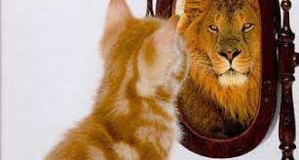
The perception process
Not always based on true pictures of reality.
We behave as though our perceptions are real.
Influenced by our prior knowledge and experience.

Slide 6
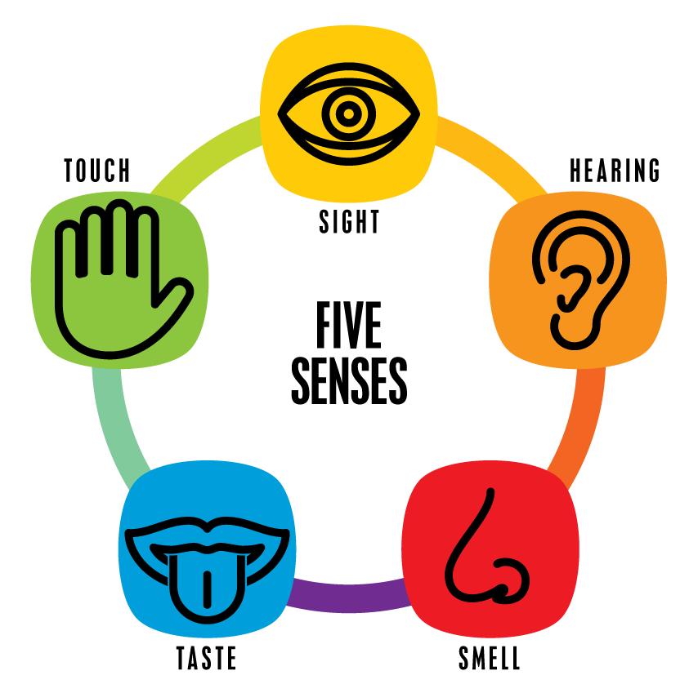
Stages of perception
Selection: Information is received via the senses and attended to by the brain.
Categorisation: The process of ordering the environment by grouping persons, objects and events on the basis of their similarities.
Interpretation: Attachment of meaning to data obtained through the sensory organs.

Slide 7
Ingroups and outgroups
Ingroup (us) represents a special class of membership group characterised by internal cohesiveness among its members.
Outgroup (them) is a group whose attributes are dissimilar from those of the ingroup.
People tend to see members of outgroups as “all alike”, without recognising the individual differences that we appreciate in ingroup members; this is called the outgroup homogeneity effect.

Slide 8
Attribution theory
The theory assumes that a person seeking to understand why another person acted in a certain way may attribute one or more causes to the behaviour in question.
Internal attribution refers to the inference that a person is behaving in a certain way because of something about that person. External attribution ascribes situational causes to a person’s behaviour.

Slide 9
Attribution theory
Desirable Undesirable
Ingroups
Outgroups
Internal attribution (dispositional) | External attribution (situational)
External attribution (situational) | Internal attribution (dispositional)

Slide 10
Sources of identities
Culture, religion, gender, class, race, ethnicity, political affiliation, social groups, occupation, and geographic region, to mention just a few, can all be used to define groups and hence identities.

Slide 11
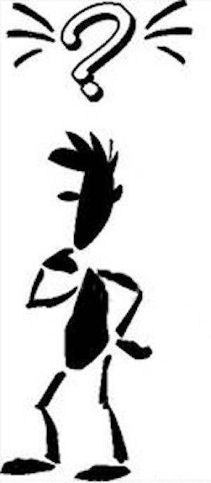
Defining identities
A person’s subjective experience of himself or herself in relation to the world.
Formed through cultural processes.
A sense of place in the world.
Manifesting personal or group characteristics.
Can be self-defined or ascribed by others.

Slide 12
Identity negotiation
Identity negotiation is present through all interactions during which communicators simultaneously attempt to evoke their own desired identities and also challenge or support others’ identities.

Slide 13
Stereotypes
Pre-conceived beliefs.
Associated with a group or category of people, but may not be generalisable to the entire group.
Can be formed from a false association between two variables.
Can be favourable or unfavourable.
What are the sources of stereotypes?

Slide 14
Ethnocentrism
“Groups develop differences from one another, so do formal organizations, communities and societies. Without interaction with outsiders, differences become difficult to understand and difficult not to judge. What is real to us becomes comfortable; what is comfortable becomes right. What we do not understand becomes less than right to us”.
Source: Charon, J. M. (2007). Ten questions: A sociological
perspective (6th ed). Belmont, CA: Wadsworth. p. 156.

Slide 15
Prejudice
Prejudice is the result of generalised evaluations about a person, object or action and can manifest biased attitudes or behaviours towards the relevant party.
The mass media can play a significant role in creating and perpetuating prejudice and stereotypes.

Slide 16
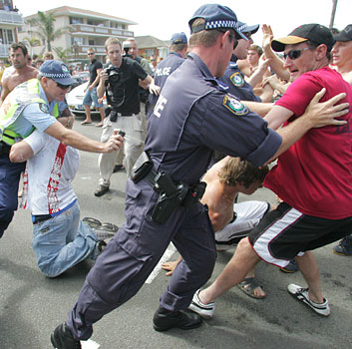
Racism
The belief that one racial group is superior to all others.
The product of ignorance, hatred and fear of difference, including differences in customs, values, religion, or appearance.

Slide 17
After class…
Write down one stereotype, when and where you learned it, who taught it to you, and how it might have affected your attitude and behaviour. How true is this stereotype? Has it changed over the past years or has it remained the same? Why?

Slide 18
Next week…
In Week 5, we will discuss various ways in which media bring about change to society and culture.

